Slide 1
Final Engagement
Attack, Defense & Analysis of a Vulnerable Network

Slide 2
Table of Contents
This document contains the following resources:
Network Topology & Critical Vulnerabilities
Traffic Profile
Normal Activity
Malicious Activity

Slide 3
Network Topology
& Critical Vulnerabilities
‹#›

Slide 4
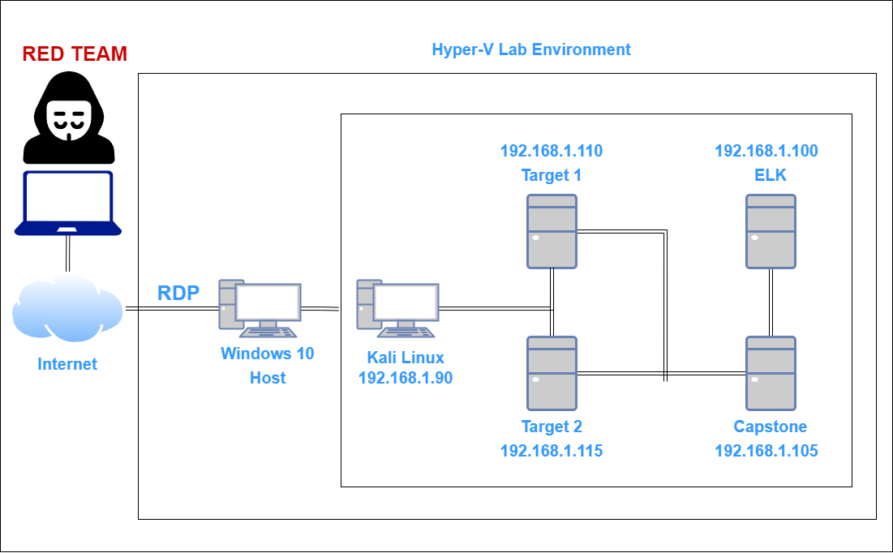
Network Topology
Network
Address Range: 192.168.1.1/24
Gateway: 192.168.1.1
Machines
IPv4: 192.168.1.90
OS: Kali Linux
Hostname: kali
IPv4: 192.168.1.110
OS: Linux
Hostname: Target1
IPv4: 192.168.1.115
OS: Linux
Hostname: Target2
IPv4: 192.168.1.100
OS: Linux
Hostname: ELK

Slide 5
Critical Vulnerabilities: Target 1
Our assessment uncovered the following critical vulnerabilities in Target 1.
Vulnerability | Description | Impact
Wordpress Core not updated | Security Patches needed | High
AntiMalware/AV | Install needed | High
No Firewall Rules | WAF needed | High

Slide 6
Traffic Profile
‹#›

Slide 7
Traffic Profile
Our analysis identified the following characteristics of the traffic on the network:
Feature | Value | Description
Top Talkers (IP Addresses) | 172.16.4.205, 185.243.115.84 | Machines that sent the most traffic.
Most Common Protocols | TCP, UDP | Three most common protocols on the network.
# of Unique IP Addresses | 808 | Count of observed IP addresses.
Subnets | 4 | Observed subnet ranges.
# of Malware Species | 2 | Number of malware binaries identified in traffic.
Notes:
You may have more than 2 subnets.

Slide 8
Behavioral Analysis
Purpose of Traffic on the Network
Users were observed engaging in the following kinds of activity.
“Normal” Activity
Watching YouTube
Reading the news
Searches in browser
Suspicious Activity
Sending and receiving malware, spyware and phishing
Illegal downloads

Slide 9
Normal Activity
‹#›

Slide 10
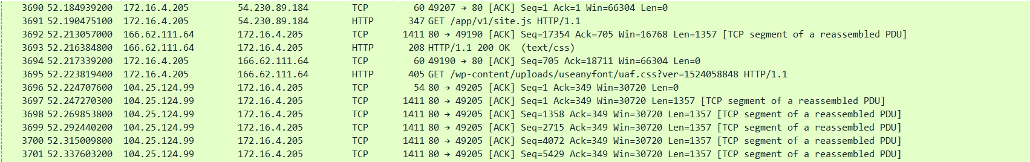
Browsing the Internet
This normal behavior consists of:
HTTP GET requests and POST using TCP and UDP protocols
Browsing the internet, streaming videos and YouTube
Most of the normal traffic downloads consisted of files needed for browser translation (.js, .php, etc.)

Slide 11
Malicious Activity
‹#›

Slide 12
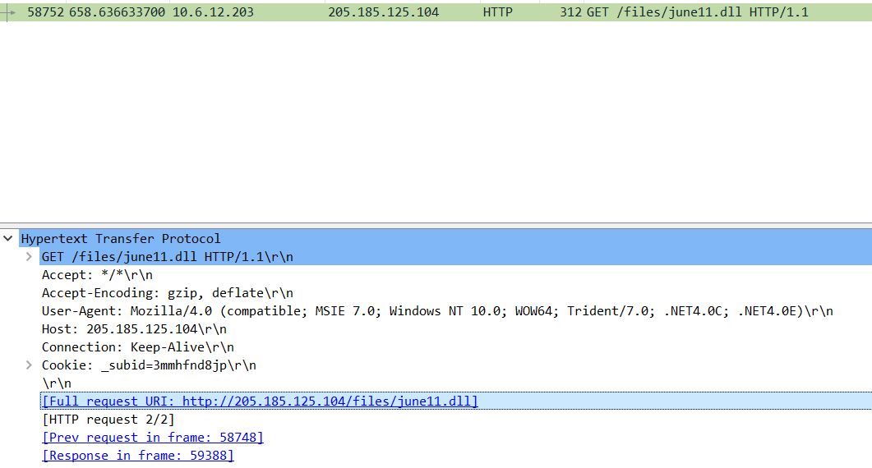
Downloading Malware and Illegal Downloads
This malicious behavior consists of:
Downloading suspicious files from unknown websites
Downloading copyrighted files and artwork
Users were seen downloading files that seemed harmless, but were classified as malware
One file in question is: http://205.185.125.104/files/june11.dll

Slide 13
The End
‹#›

